Slide 1


Slide 2


Slide 3
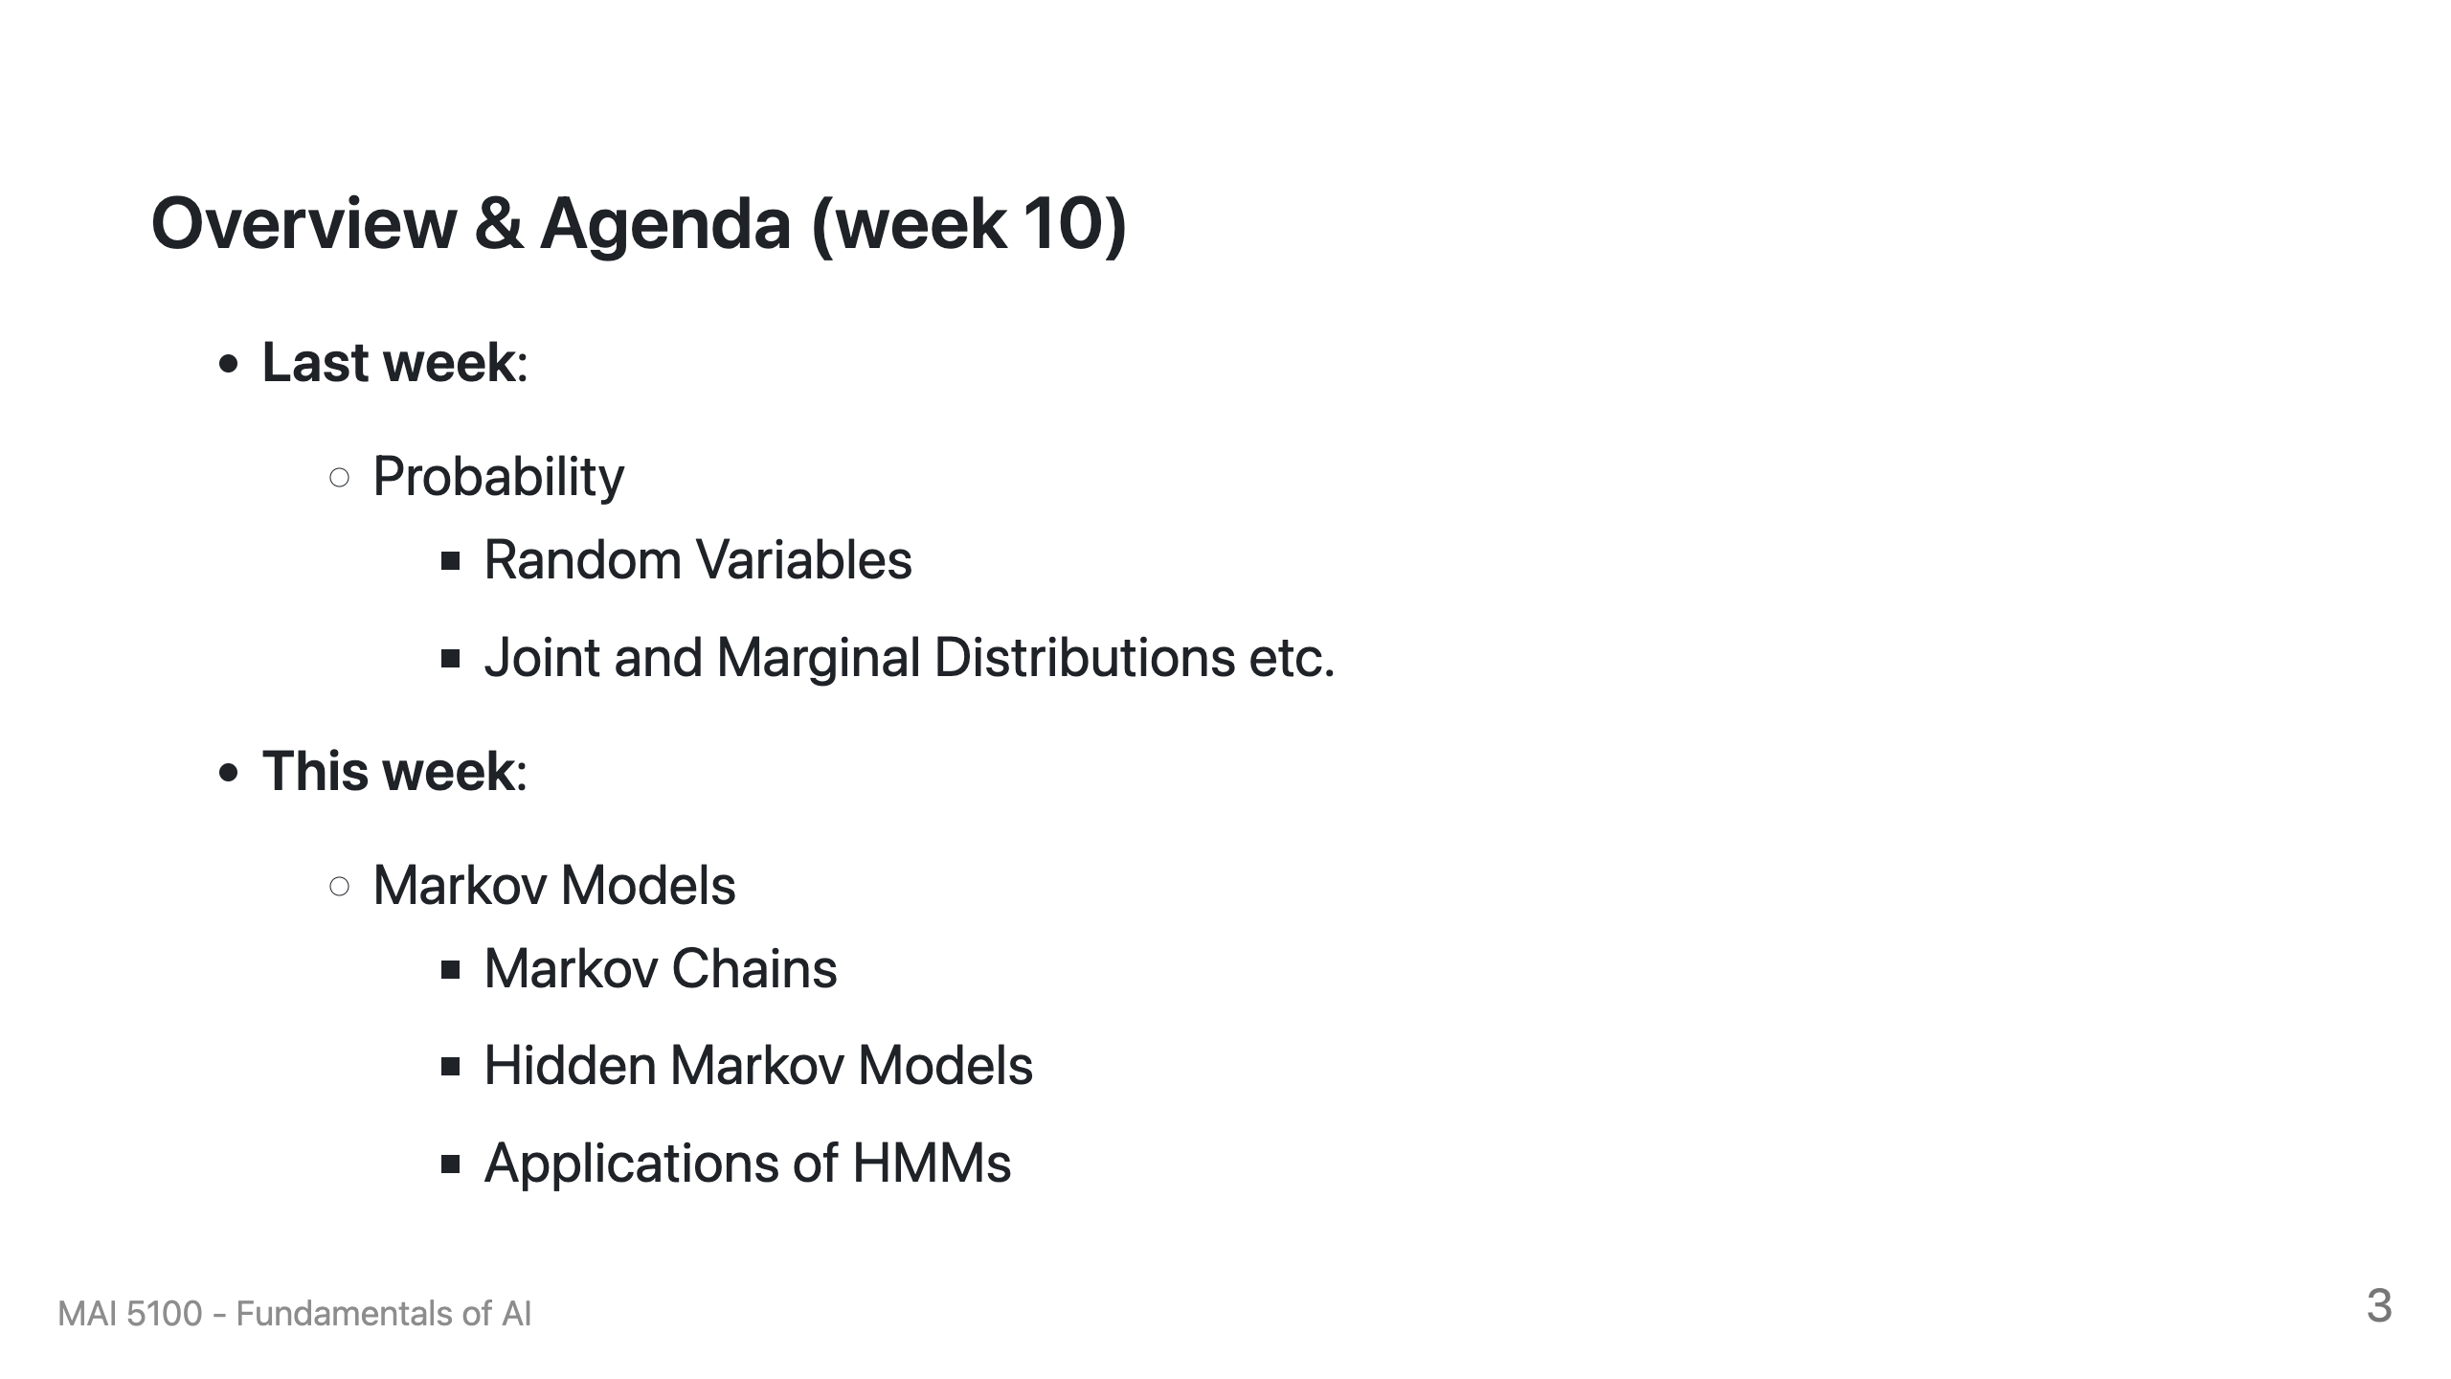

Slide 4

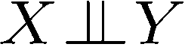
Independence
Two variables are independent in a joint distribution if:
Says the joint distribution factors into a product of two simple ones
Usually variables aren’t independent!
Can use independence as a modeling assumption
Independence can be a simplifying assumption
Empirical joint distributions: at best “close” to independent
What could we assume for {Weather, Traffic, Cavity}?
Independence is like something from CSPs: what?

Slide 5
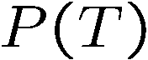
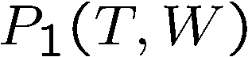
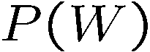
Example: Independence?
T | P
hot | 0.5
cold | 0.5
T | W | P
hot | sun | 0.4
hot | rain | 0.1
cold | sun | 0.2
cold | rain | 0.3
T | W | P
hot | sun | 0.3
hot | rain | 0.2
cold | sun | 0.3
cold | rain | 0.2
W | P
sun | 0.6
rain | 0.4

Slide 6

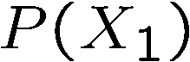
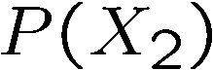
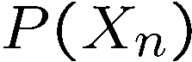
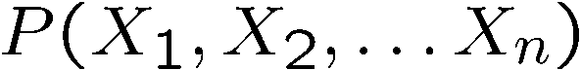

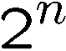
Example: Independence
N fair, independent coin flips:
H | 0.5
T | 0.5
H | 0.5
T | 0.5
H | 0.5
T | 0.5

Slide 7
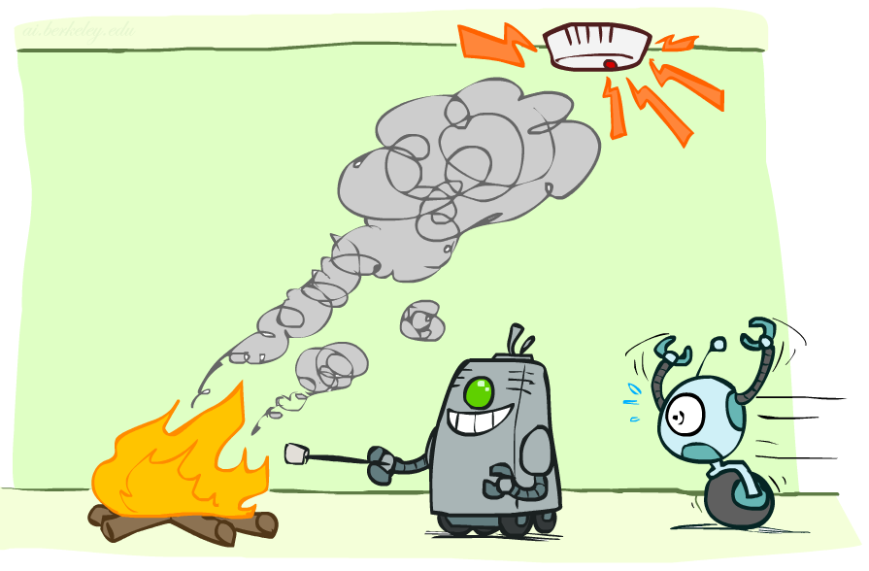
Conditional Independence

Slide 8

Conditional Independence
P(Toothache, Cavity, Catch)
If I have a cavity, the probability that the probe catches in it doesn't depend on whether I have a toothache:
P(+catch | +toothache, +cavity) = P(+catch | +cavity)
The same independence holds if I don’t have a cavity:
P(+catch | +toothache, -cavity) = P(+catch| -cavity)
Catch is conditionally independent of Toothache given Cavity:
P(Catch | Toothache, Cavity) = P(Catch | Cavity)
Equivalent statements:
P(Toothache | Catch , Cavity) = P(Toothache | Cavity)
P(Toothache, Catch | Cavity) = P(Toothache | Cavity) P(Catch | Cavity)
One can be derived from the other easily

Slide 9
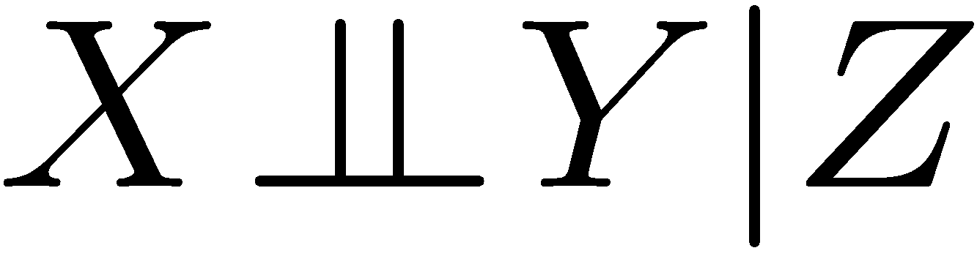
Conditional Independence
Unconditional (absolute) independence very rare (why?)
Conditional independence is our most basic and robust form of knowledge about uncertain environments.
X is conditionally independent of Y given Z
if and only if:
or, equivalently, if and only if

Slide 10
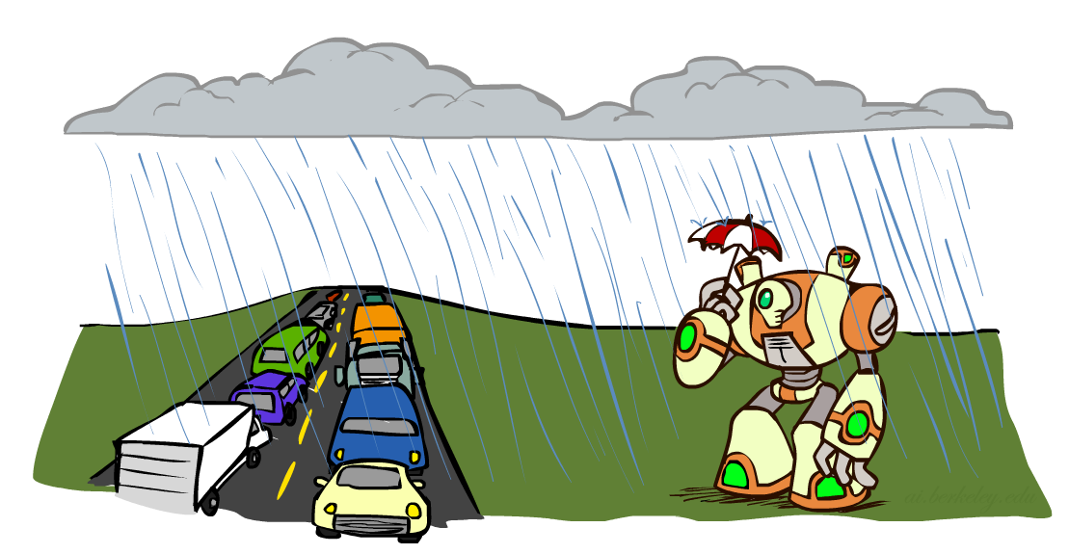
Conditional Independence
What about this domain:
Traffic
Umbrella
Raining

Slide 11

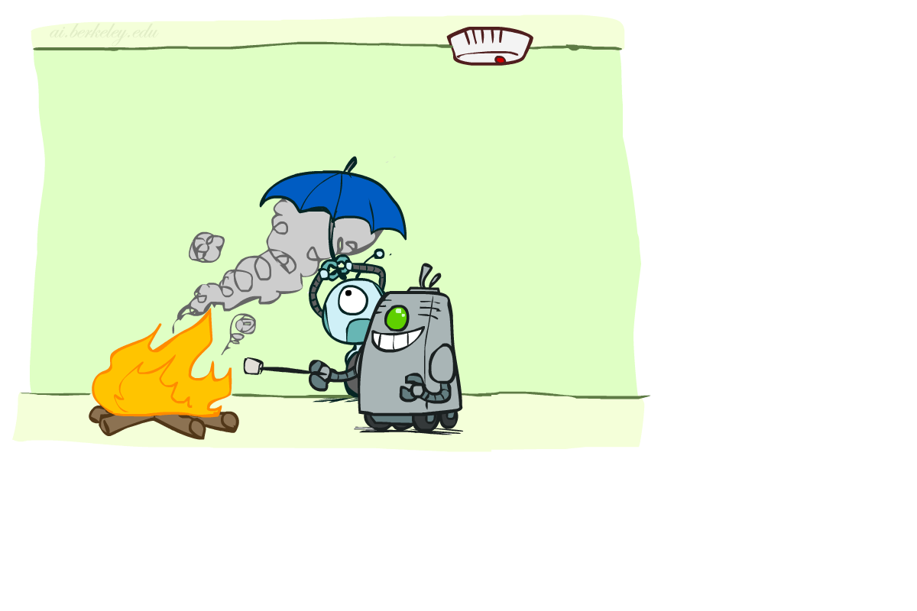
Conditional Independence
What about this domain:
Fire
Smoke
Alarm

Slide 12
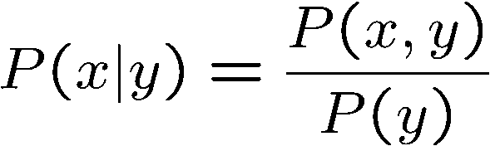
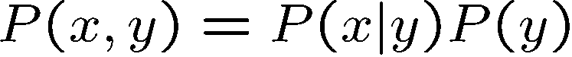
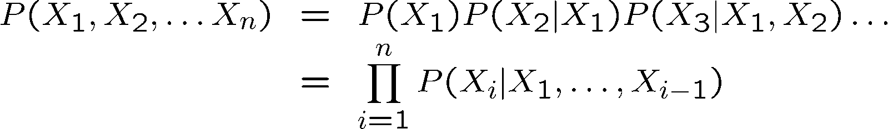

Probability Recap
Conditional probability
Product rule
Chain rule
X, Y independent if and only if:
X and Y are conditionally independent given Z if and only if:

Slide 13
Reasoning over Time or Space
Often, we want to reason about a sequence of observations
Speech recognition
Robot localization
User attention
Medical monitoring
Need to introduce time (or space) into our models

Slide 14

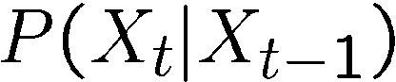
Markov Models
Value of X at a given time is called the state
Parameters: called transition probabilities or dynamics, specify how the state evolves over time (also, initial state probabilities)
Stationarity assumption: transition probabilities the same at all times
Same as MDP transition model, but no choice of action
X₁
X₂
X₃
X₄

Slide 15
Joint Distribution of a Markov Model
X₁
X₂
X₃
X₄
Joint distribution:
More generally:
Questions to be resolved:
Does this indeed define a joint distribution?
Can every joint distribution be factored this way, or are we making some assumptions about the joint distribution by using this factorization?

Slide 16
Chain Rule and Markov Models
X₁
X₂
X₃
X₄
From the chain rule, every joint distribution over can be written as:
Assuming that
and
results in the expression posited on the previous slide:

Slide 17
Chain Rule and Markov Models
X₁
X₂
X₃
X₄
From the chain rule, every joint distribution over can be written as:
Assuming that for all t:
gives us the expression posited on the earlier slide:

Slide 18
Implied Conditional Independencies
X₁
X₂
X₃
X₄
We assumed: and
Do we also have ?
Yes!
Proof:

Slide 19
Markov Models Recap
Explicit assumption for all t :
Consequence, joint distribution can be written as:
Implied conditional independencies: (try to prove this!)
Past variables independent of future variables given the present
i.e., if or then:
Additional explicit assumption: is the same for all t

Slide 20

Conditional Independence
Basic conditional independence:
Past and future independent of the present
Each time step only depends on the previous
This is called the (first order) Markov property
Note that the chain is just a (growable) BN
We can always use generic BN reasoning on it if we truncate the chain at a fixed length

Slide 21
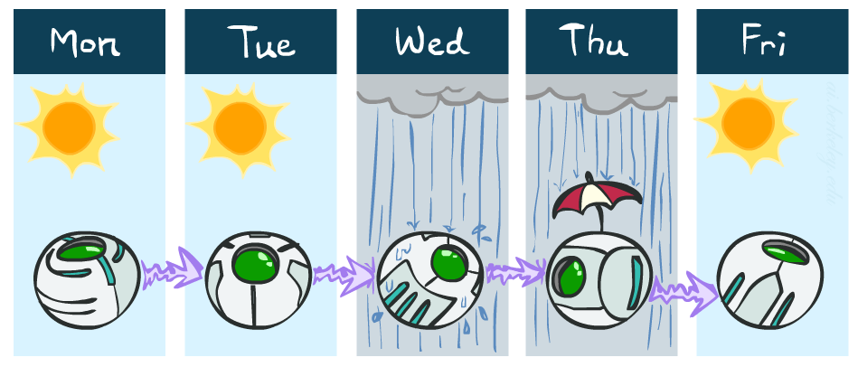
Example Markov Chain: Weather
States: X = {rain, sun}
Initial distribution: 1.0 sun
CPT P(X_{t} | X_{t-1}):
Two new ways of representing the same CPT
X_{t-1} | X_{t} | P(X_{t}|X_{t-1})
sun | sun | 0.9
sun | rain | 0.1
rain | sun | 0.3
rain | rain | 0.7
0.9
0.3
0.9
rain
sun
sun
sun
0.1
0.3
rain
rain
0.7
0.7
0.1

Slide 22
Example Markov Chain: Weather
0.9
Initial distribution: 1.0 sun
What is the probability distribution after one step?
0.3
rain
sun
0.7
0.1

Slide 23
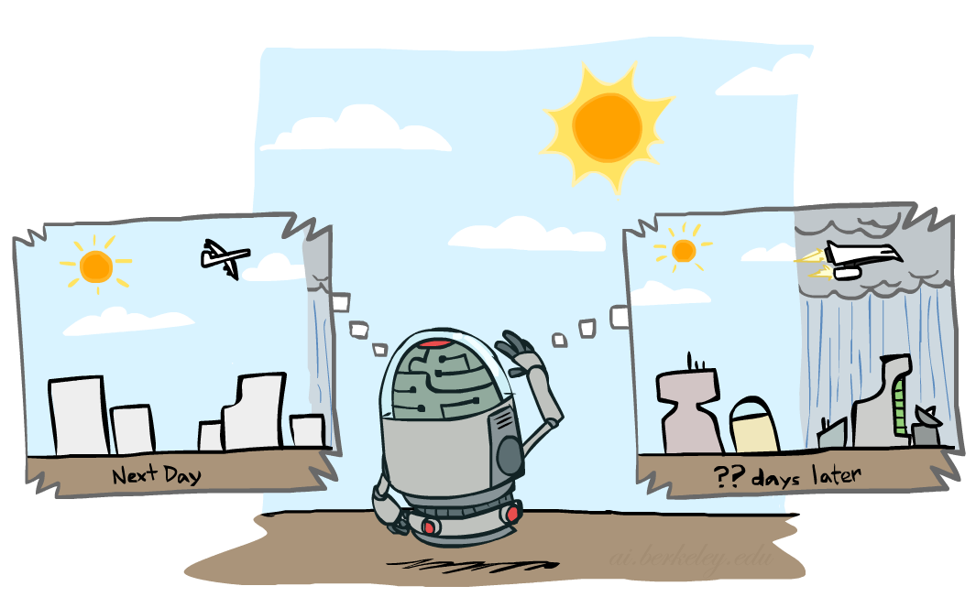

Mini-Forward Algorithm
Question: What’s P(X) on some day t?
X₁
X₂
X₃
X₄
Forward simulation

Slide 24
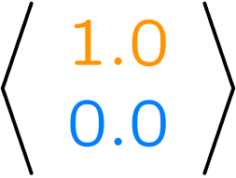
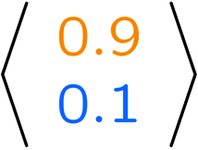
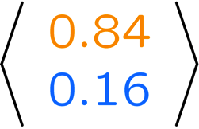
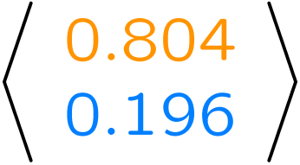
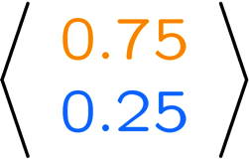
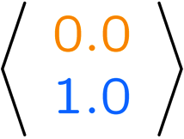
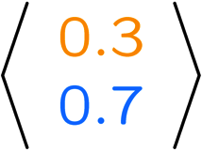
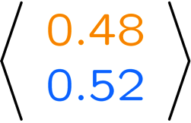
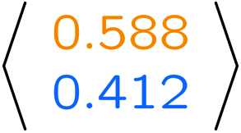
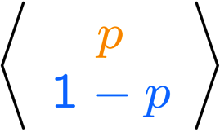
Example Run of Mini-Forward Algorithm
From initial observation of sun
From initial observation of rain
From yet another initial distribution P(X₁):
P(X₁)
P(X₂)
P(X₃)
P(X₄)
P(X∞)
P(X₁)
P(X₂)
P(X₃)
P(X₄)
P(X∞)
…
P(X₁)
P(X∞)
[Demo: L13D1,2,3]

Slide 25

Video of Demo Ghostbusters Basic Dynamics

Slide 26
Video of Demo Ghostbusters Circular Dynamics

Slide 27
Video of Demo Ghostbusters Whirlpool Dynamics

Slide 28

Stationary Distributions
For most chains:
Influence of the initial distribution gets less and less over time.
The distribution we end up in is independent of the initial distribution
Stationary distribution:
The distribution we end up with is called the stationary distribution of the chain
It satisfies

Slide 29
Example: Stationary Distributions
Question: What’s P(X) at time t = infinity?
X₁
X₂
X₃
X₄
X_{t-1} | X_{t} | P(X_{t}|X_{t-1})
sun | sun | 0.9
sun | rain | 0.1
rain | sun | 0.3
rain | rain | 0.7
Also:

Slide 30
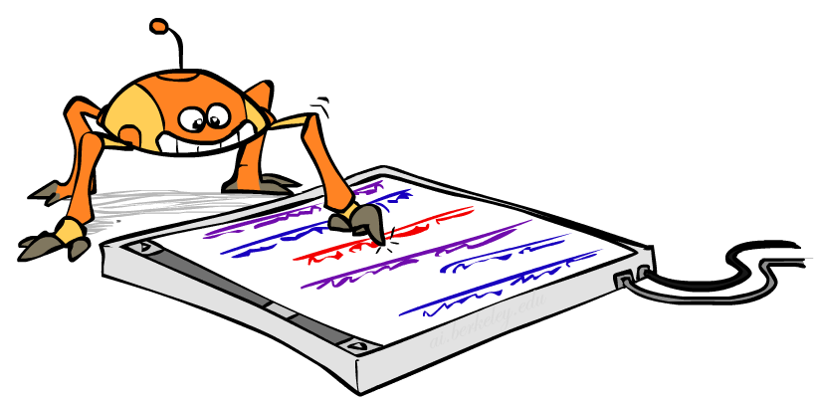
Application of Stationary Distribution: Web Link Analysis
PageRank over a web graph
Each web page is a state
Initial distribution: uniform over pages
Transitions:
With prob. c, uniform jump to a
random page (dotted lines, not all shown)
With prob. 1-c, follow a random
outlink (solid lines)
Stationary distribution
Will spend more time on highly reachable pages
E.g. many ways to get to the Acrobat Reader download page
Somewhat robust to link spam
Google 1.0 returned the set of pages containing all your keywords in decreasing rank, now all search engines use link analysis along with many other factors (rank actually getting less important over time)
Notes:
Before: most search engines were merely based on how well a page matches your search words.
Note: currently dominated by clickstreams

Slide 31

Application of Stationary Distributions: Gibbs Sampling*
Each joint instantiation over all hidden and query variables is a state: {X₁, …, X_{n}} = H U Q
Transitions:
With probability 1/n resample variable X_{j} according to
P(X_{j} | x₁, x₂, …, x_{j-1,} x_{j+1}, …, x_{n,} e_{1,} …, e_{m})
Stationary distribution:
Conditional distribution P(X₁, X₂ , … , X_{n}|e_{1,} …, e_{m})
Means that when running Gibbs sampling long enough we get a sample from the desired distribution
Requires some proof to show this is true!
Notes:
With re-ordering of topics, can’t cover this here yet, need to wait till after sampling.

Slide 32

Hidden Markov Models

Slide 33
Hidden Markov Models
Markov chains not so useful for most agents
Need observations to update your beliefs
Hidden Markov models (HMMs)
Underlying Markov chain over states X
You observe outputs (effects) at each time step
X₁
X₂
X₃
X₄
X₅
E₁
E₂
E₃
E₄
E₅

Slide 34


Example: Weather HMM
Rain_{t-1}
Rain_{t}
Rain_{t+1}
Umbrella_{t-1}
Umbrella_{t}
Umbrella_{t+1}
An HMM is defined by:
Initial distribution:
Transitions:
Emissions:
R_{t} | R_{t+1} | P(R_{t+1}|R_{t})
+r | +r | 0.7
+r | -r | 0.3
-r | +r | 0.3
-r | -r | 0.7
R_{t} | U_{t} | P(U_{t}|R_{t})
+r | +u | 0.9
+r | -u | 0.1
-r | +u | 0.2
-r | -u | 0.8
Notes:
demo

Slide 35


Example: Ghostbusters HMM
P(X₁) = uniform
P(X|X’) = usually move clockwise, but sometimes move in a random direction or stay in place
P(R_{ij}|X) = same sensor model as before: red means close, green means far away.
1/9
1/9
1/9
1/9
1/9
1/9
1/9
1/9
1/9
P(X₁)
1/6
1/6
1/2
0
1/6
0
X₁
X₂
X₃
X₄
0
0
0
X₅
P(X|X’=<1,2>)
R_{i,j}
R_{i,j}
R_{i,j}
R_{i,j}
[Demo: Ghostbusters – Circular Dynamics – HMM (L14D2)]
Notes:
Dan has some demo for this.

Slide 36
Video of Demo Ghostbusters – Circular Dynamics -- HMM

Slide 37
Joint Distribution of an HMM
X₁
X₂
X₃
X₅
E₁
E₂
E₃
E₅
Joint distribution:
More generally:
Questions to be resolved:
Does this indeed define a joint distribution?
Can every joint distribution be factored this way, or are we making some assumptions about the joint distribution by using this factorization?

Slide 38
Chain Rule and HMMs
X₁
X₂
X₃
E₁
E₂
E₃
From the chain rule, every joint distribution over can be written as:
Assuming that
gives us the expression posited on the previous slide:

Slide 39
Chain Rule and HMMs
X₁
X₂
X₃
E₁
E₂
E₃
From the chain rule, every joint distribution over can be written as:
Assuming that for all t:
State independent of all past states and all past evidence given the previous state, i.e.:
Evidence is independent of all past states and all past evidence given the current state, i.e.:
gives us the expression posited on the earlier slide:

Slide 40
Implied Conditional Independencies
X₁
X₂
X₃
E₁
E₂
E₃
Many implied conditional independencies, e.g.,
To prove them
Approach 1: follow similar (algebraic) approach to what we did in the Markov models lecture
Approach 2: directly from the graph structure (3 lectures from now)
Intuition: If path between U and V goes through W, then
[Some fineprint later]

Slide 41
HMMs Recap
Explicit assumption for all t :
Consequence, joint distribution can be written as:
Implied conditional independencies:
Past variables independent of future variables given the present
i.e., if or then:
Additional explicit assumption: is the same for all t

Slide 42
Conditional Independence
HMMs have two important independence properties:
Markov hidden process: future depends on past via the present
Current observation independent of all else given current state
Quiz: does this mean that evidence variables are guaranteed to be independent?
[No, they tend to correlated by the hidden state]
X₁
X₂
X₃
X₄
X₅
E₁
E₂
E₃
E₄
E₅

Slide 43
Real HMM Examples
Speech recognition HMMs:
Observations are acoustic signals (continuous valued)
States are specific positions in specific words (so, tens of thousands)
Machine translation HMMs:
Observations are words (tens of thousands)
States are translation options
Robot tracking:
Observations are range readings (continuous)
States are positions on a map (continuous)

Slide 44
Filtering / Monitoring
Filtering, or monitoring, is the task of tracking the distribution B_{t}(X) = P_{t}(X_{t} | e₁, …, e_{t}) (the belief state) over time
We start with B₁(X) in an initial setting, usually uniform
As time passes, or we get observations, we update B(X)
The Kalman filter was invented in the 60’s and first implemented as a method of trajectory estimation for the Apollo program
Notes:
Dan has some demo for this

Slide 45
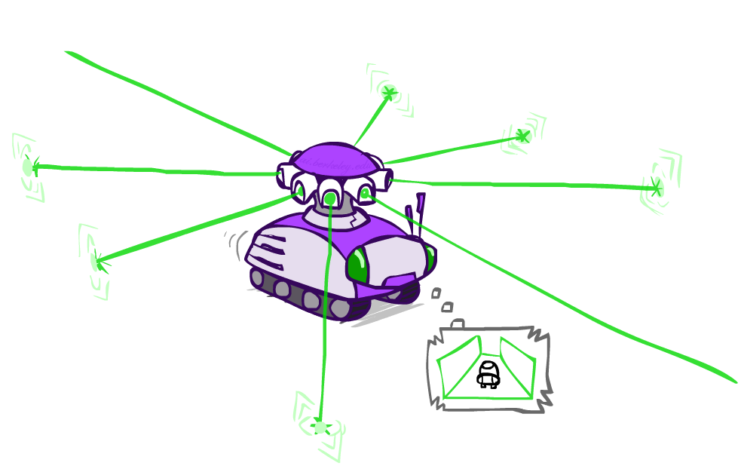
Example: Robot Localization
Example from Michael Pfeiffer
Prob
0
1
t=0
Sensor model: can read in which directions there is a wall, never more than 1 mistake
Motion model: may not execute action with small prob.

Slide 46
Example: Robot Localization
Prob
0
1
t=1
Lighter grey: was possible to get the reading, but less likely b/c required 1 mistake

Slide 47
Example: Robot Localization
Prob
0
1
t=2

Slide 48
Example: Robot Localization
Prob
0
1
t=3

Slide 49
Example: Robot Localization
Prob
0
1
t=4

Slide 50
Example: Robot Localization
Prob
0
1
t=5

Slide 51
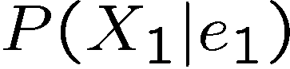

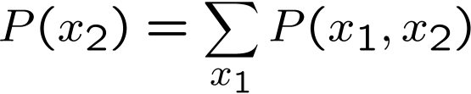
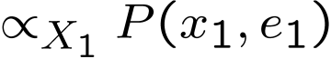
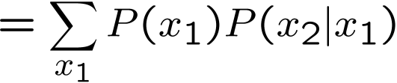
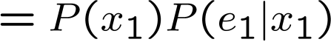
Inference: Base Cases
X₁
X₁
X₂
E₁

Slide 52
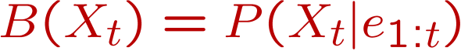
Passage of Time
Assume we have current belief P(X | evidence to date)
Then, after one time step passes:
Basic idea: beliefs get “pushed” through the transitions
With the “B” notation, we have to be careful about what time step t the belief is about, and what evidence it includes
X₁
X₂
Or compactly:
Notes:
TODO: intermediate step in derivation!

Slide 53

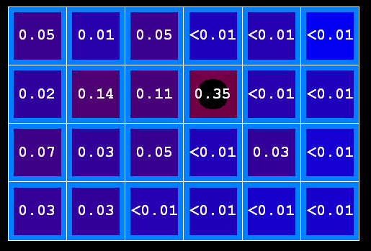
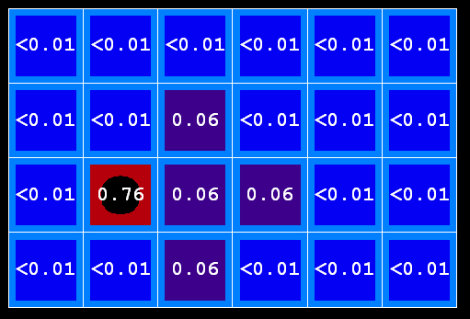
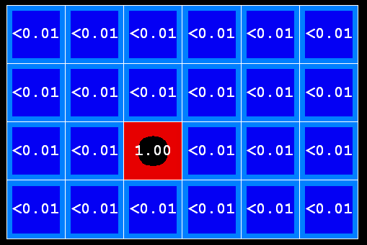
Example: Passage of Time
As time passes, uncertainty “accumulates”
(Transition model: ghosts usually go clockwise)
T = 1
T = 2
T = 5

Slide 54
Observation
X₁
Assume we have current belief P(X | previous evidence):
Then, after evidence comes in:
Or, compactly:
E₁
Basic idea: beliefs “reweighted” by likelihood of evidence
Unlike passage of time, we have to renormalize
Notes:
Basic idea: beliefs “reweighted” by likelihood of evidence
Unlike passage of time, we have to renormalize

Slide 55


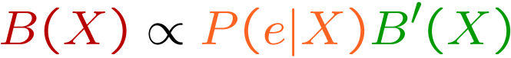
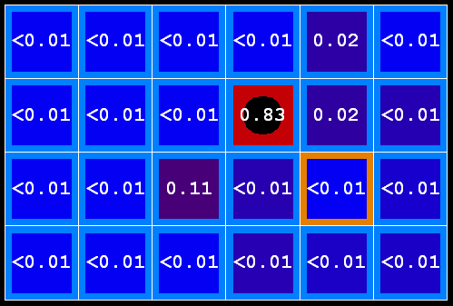
Example: Observation
As we get observations, beliefs get reweighted, uncertainty “decreases”
Before observation
After observation

Slide 56
Example: Weather HMM
B’(+r) = 0.5
B’(-r) = 0.5
B’(+r) = 0.627
B’(-r) = 0.373
B(+r) = 0.5
B(-r) = 0.5
B(+r) = 0.818
B(-r) = 0.182
B(+r) = 0.883
B(-r) = 0.117
Rain₀
Rain₁
Rain₂
R_{t} | R_{t+1} | P(R_{t+1}|R_{t})
+r | +r | 0.7
+r | -r | 0.3
-r | +r | 0.3
-r | -r | 0.7
R_{t} | U_{t} | P(U_{t}|R_{t})
+r | +u | 0.9
+r | -u | 0.1
-r | +u | 0.2
-r | -u | 0.8
Umbrella₁
Umbrella₂
Notes:
demo

Slide 57
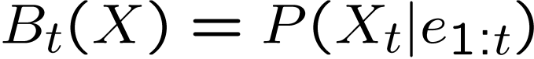
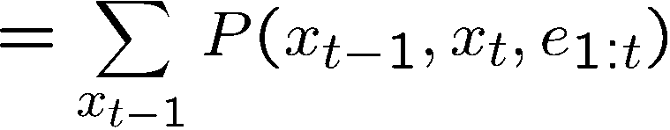
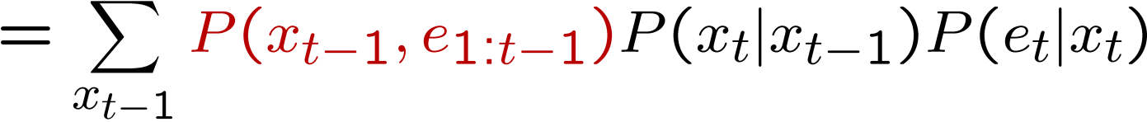
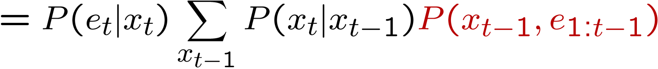
The Forward Algorithm
We are given evidence at each time and want to know
We can derive the following updates
We can normalize as we go if we want to have P(x|e) at each time step, or just once at the end…
Notes:
TODO: explain propto and it’s X_t, not X

Slide 58
Online Belief Updates
Every time step, we start with current P(X | evidence)
We update for time:
We update for evidence:
The forward algorithm does both at once (and doesn’t normalize)
X₁
X₂
X₂
E₂

Slide 59
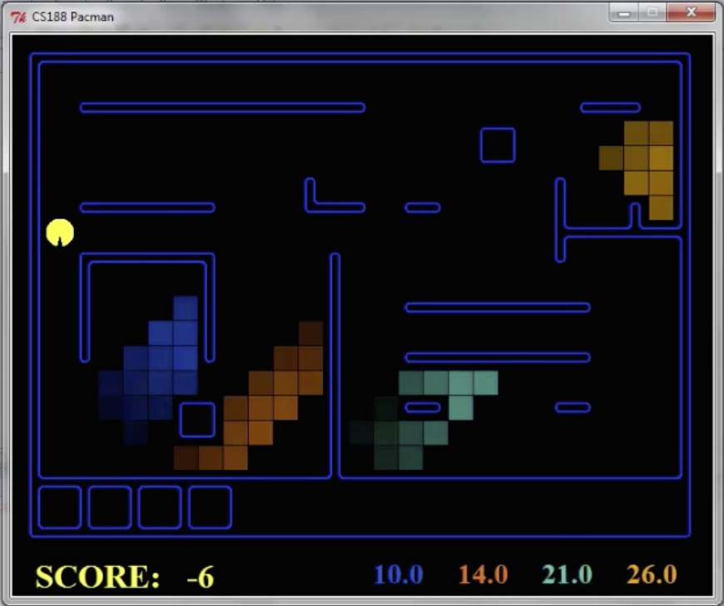
Pacman – Sonar (P4)
[Demo: Pacman – Sonar – No Beliefs(L14D1)]

Slide 60
Video of Demo Pacman – Sonar (with beliefs)

